Slide 1
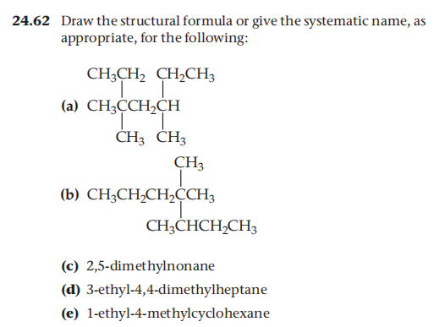

Homework review
1.Write all the structural isomers of heptane
2.P1181 24.62、24.64
Notes:
Let's cover three interconnected concepts. First, IUPAC nomenclature — the prefix indicates the number of carbon atoms: meth- for 1, eth- for 2, prop- for 3, and so on up to dec- for 10. The suffix '-ane' identifies the compound as an alkane. So 'hexane' tells you immediately: 6 carbons, all single bonds. Second, the homologous series — this is a family of compounds where each successive member differs by exactly one CH₂ unit. Members share the same general formula, similar chemical properties, and show gradual changes in physical properties. This is one of the most powerful predictive frameworks in organic chemistry. Third, real-world applications: methane and butane (C₁–C₄) serve as gaseous fuels — methane for heating, butane for lighters. Longer-chain alkanes from C₂₀ to C₃₀ are used in candles, waxes, and lubricants due to their stability and high viscosity.

Slide 2
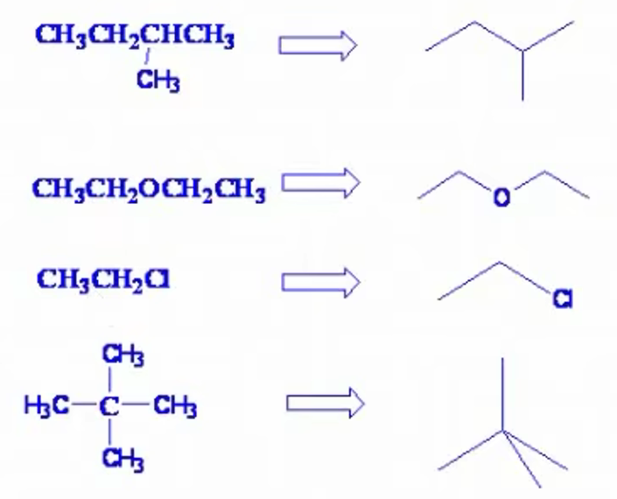
Skeletal Formula(键线式)
C and H are omitted（省略）, while other elements must not be omitted.
Endpoints（端点） and vertices（拐角） each represent a carbon atom.
A single line represents a single bond, a double line represents a double bond, and a triple line represents a triple bond.
Skeletal formulas are generally not used for methane, ethane, ethene, and ethyne.
Notes:
Now let's examine the first 10 straight-chain alkanes in detail — this is Table 24.3 from your textbook, and it's one of the most important reference tables in organic chemistry. Notice the systematic pattern: each successive member adds exactly one CH₂ unit. Watch the boiling points — they increase from methane at −161°C all the way to decane at 174°C. This is a direct consequence of increasing London dispersion forces as the molecular surface area grows. Also note the critical phase transition: alkanes with 1 to 4 carbon atoms are gases at room temperature, those with 5 to 17 carbons are liquids, and those with 18 or more are solids. This gas-to-liquid boundary between butane (−0.5°C) and pentane (36°C) is frequently tested on AP exams.

Slide 3
Homework review
1.Write all the structural isomers of heptane
2.P1181 24.62、24.64
Notes:
Let's cover three interconnected concepts. First, IUPAC nomenclature — the prefix indicates the number of carbon atoms: meth- for 1, eth- for 2, prop- for 3, and so on up to dec- for 10. The suffix '-ane' identifies the compound as an alkane. So 'hexane' tells you immediately: 6 carbons, all single bonds. Second, the homologous series — this is a family of compounds where each successive member differs by exactly one CH₂ unit. Members share the same general formula, similar chemical properties, and show gradual changes in physical properties. This is one of the most powerful predictive frameworks in organic chemistry. Third, real-world applications: methane and butane (C₁–C₄) serve as gaseous fuels — methane for heating, butane for lighters. Longer-chain alkanes from C₂₀ to C₃₀ are used in candles, waxes, and lubricants due to their stability and high viscosity.

Slide 4
Homework review
1.Write all the structural isomers of heptane
2.P1181 24.62、24.64
Notes:
Let's cover three interconnected concepts. First, IUPAC nomenclature — the prefix indicates the number of carbon atoms: meth- for 1, eth- for 2, prop- for 3, and so on up to dec- for 10. The suffix '-ane' identifies the compound as an alkane. So 'hexane' tells you immediately: 6 carbons, all single bonds. Second, the homologous series — this is a family of compounds where each successive member differs by exactly one CH₂ unit. Members share the same general formula, similar chemical properties, and show gradual changes in physical properties. This is one of the most powerful predictive frameworks in organic chemistry. Third, real-world applications: methane and butane (C₁–C₄) serve as gaseous fuels — methane for heating, butane for lighters. Longer-chain alkanes from C₂₀ to C₃₀ are used in candles, waxes, and lubricants due to their stability and high viscosity.

Slide 5
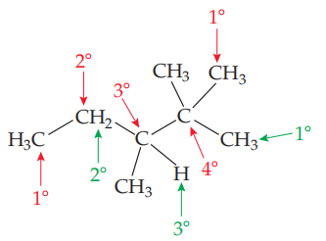
Classification of C and H P1174-1175
Primary (1°) carbon: a carbon atom bonded to one other carbon atom
1° H: a hydrogen bonded to a 1° carbon
Secondary (2°) carbon: a carbon atom bonded to two other carbon atoms
2° H: a hydrogen atom bonded to a 2° carbon
Tertiary (3°) carbon: a carbon bonded to three other carbon atoms
3° H: a hydrogen atom bonded to a 3° carbon
Quaternary (4°) carbon: a carbon bonded to four other carbon atoms
Notes:
Now let's examine the first 10 straight-chain alkanes in detail — this is Table 24.3 from your textbook, and it's one of the most important reference tables in organic chemistry. Notice the systematic pattern: each successive member adds exactly one CH₂ unit. Watch the boiling points — they increase from methane at −161°C all the way to decane at 174°C. This is a direct consequence of increasing London dispersion forces as the molecular surface area grows. Also note the critical phase transition: alkanes with 1 to 4 carbon atoms are gases at room temperature, those with 5 to 17 carbons are liquids, and those with 18 or more are solids. This gas-to-liquid boundary between butane (−0.5°C) and pentane (36°C) is frequently tested on AP exams.

Slide 6
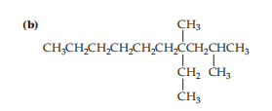
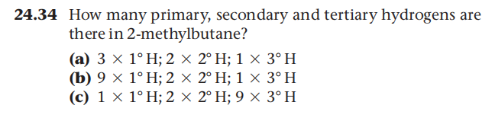
Exercise
Notes:
Now let's examine the first 10 straight-chain alkanes in detail — this is Table 24.3 from your textbook, and it's one of the most important reference tables in organic chemistry. Notice the systematic pattern: each successive member adds exactly one CH₂ unit. Watch the boiling points — they increase from methane at −161°C all the way to decane at 174°C. This is a direct consequence of increasing London dispersion forces as the molecular surface area grows. Also note the critical phase transition: alkanes with 1 to 4 carbon atoms are gases at room temperature, those with 5 to 17 carbons are liquids, and those with 18 or more are solids. This gas-to-liquid boundary between butane (−0.5°C) and pentane (36°C) is frequently tested on AP exams.

Slide 7
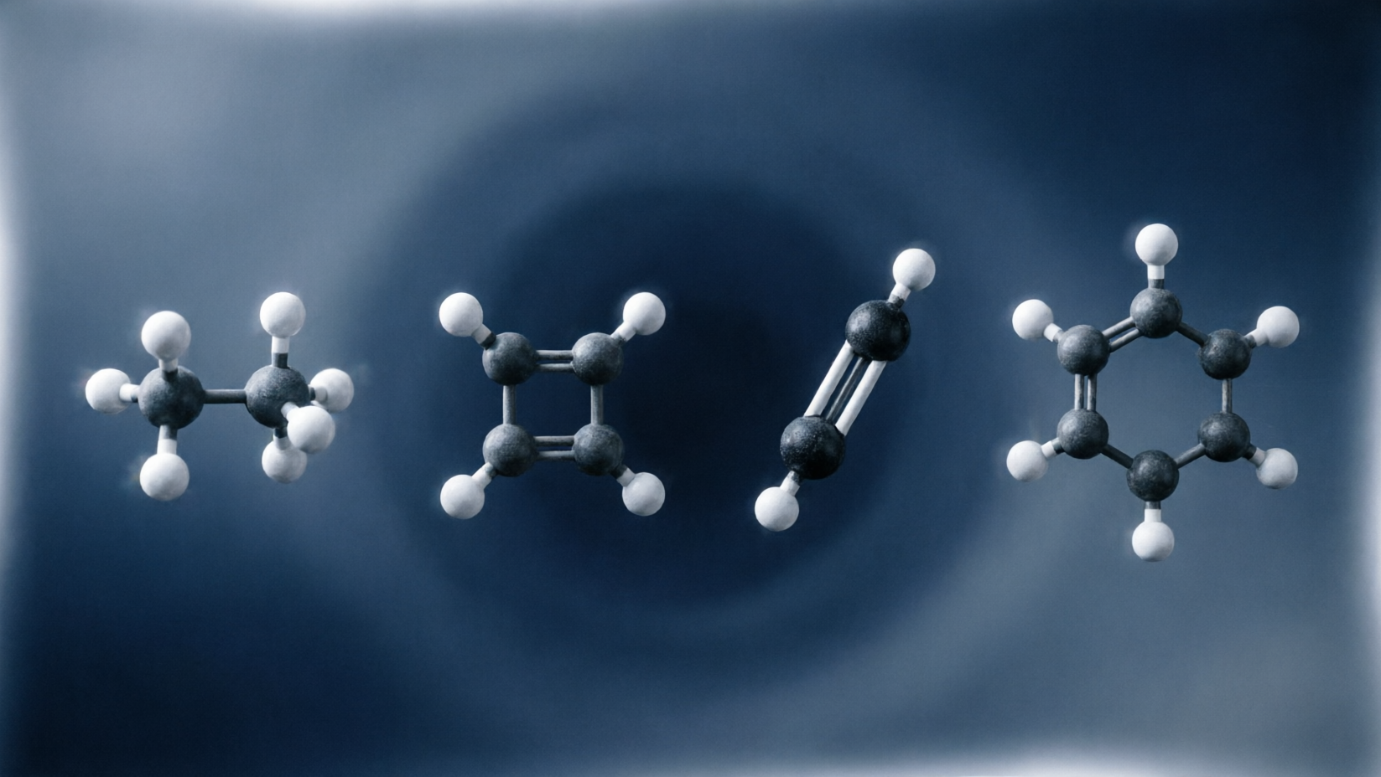
Properties of Alkanes
Notes:
Now we enter the heart of organic chemistry — hydrocarbon classification. Hydrocarbons are the simplest organic compounds, containing only carbon and hydrogen, yet they divide into four distinct families based on their carbon-carbon bond types. Mastering these four types is essential for everything that follows.

Slide 8
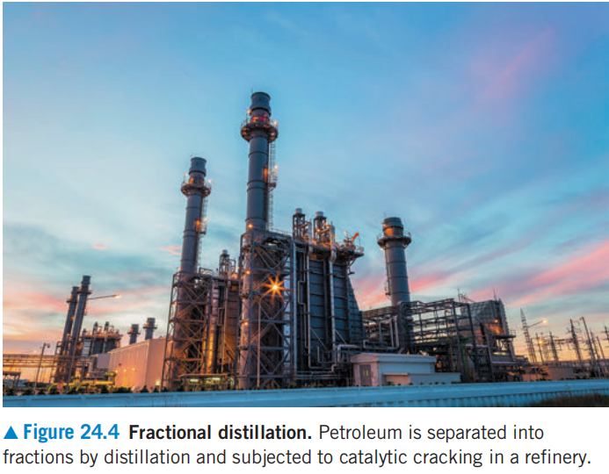
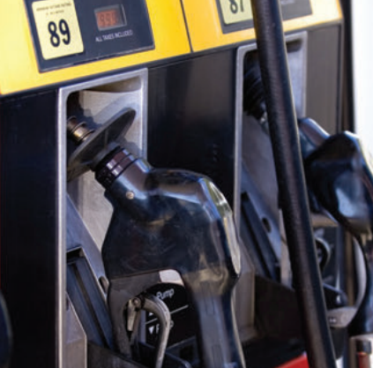

Physical Properties of Alkanes
General Formula：C_{n}H_{2n+2}
_{melting/boiling points}
n
_{density}
But its density is always lower than that of water
_{viscosity}
Solubility:All alkanes are insoluble in water.
Notes:
Now let's examine the first 10 straight-chain alkanes in detail — this is Table 24.3 from your textbook, and it's one of the most important reference tables in organic chemistry. Notice the systematic pattern: each successive member adds exactly one CH₂ unit. Watch the boiling points — they increase from methane at −161°C all the way to decane at 174°C. This is a direct consequence of increasing London dispersion forces as the molecular surface area grows. Also note the critical phase transition: alkanes with 1 to 4 carbon atoms are gases at room temperature, those with 5 to 17 carbons are liquids, and those with 18 or more are solids. This gas-to-liquid boundary between butane (−0.5°C) and pentane (36°C) is frequently tested on AP exams.

Slide 9
Chemistry Properties of Alkanes
_{Complete Combustion}
C₇H₁₄
_{Incomplete Combustion？}
Notes:
Now let's examine the first 10 straight-chain alkanes in detail — this is Table 24.3 from your textbook, and it's one of the most important reference tables in organic chemistry. Notice the systematic pattern: each successive member adds exactly one CH₂ unit. Watch the boiling points — they increase from methane at −161°C all the way to decane at 174°C. This is a direct consequence of increasing London dispersion forces as the molecular surface area grows. Also note the critical phase transition: alkanes with 1 to 4 carbon atoms are gases at room temperature, those with 5 to 17 carbons are liquids, and those with 18 or more are solids. This gas-to-liquid boundary between butane (−0.5°C) and pentane (36°C) is frequently tested on AP exams.

Slide 10
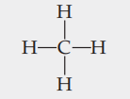
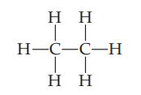
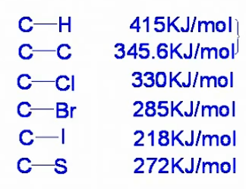
Chemistry Properties of Alkanes
General Formula：C_{n}H_{2n+2}
Energy bond
relatively large
CH₄
C₂H₆
Alkanes are relatively stable.
Alkanes can react with halogens under certain conditions
Alkanes tend to undergo free radical reactions.
Notes:
Now let's examine the first 10 straight-chain alkanes in detail — this is Table 24.3 from your textbook, and it's one of the most important reference tables in organic chemistry. Notice the systematic pattern: each successive member adds exactly one CH₂ unit. Watch the boiling points — they increase from methane at −161°C all the way to decane at 174°C. This is a direct consequence of increasing London dispersion forces as the molecular surface area grows. Also note the critical phase transition: alkanes with 1 to 4 carbon atoms are gases at room temperature, those with 5 to 17 carbons are liquids, and those with 18 or more are solids. This gas-to-liquid boundary between butane (−0.5°C) and pentane (36°C) is frequently tested on AP exams.

Slide 11
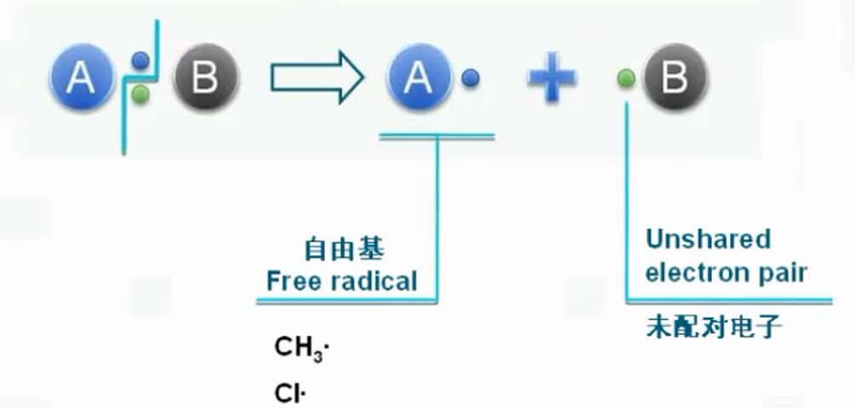
Homolytic cleavage(均裂)
Homolytic cleavage means one electron contained with the two-electron s-bond is transferred to each atom, yielding two free radicals.
Notes:
Now let's examine the first 10 straight-chain alkanes in detail — this is Table 24.3 from your textbook, and it's one of the most important reference tables in organic chemistry. Notice the systematic pattern: each successive member adds exactly one CH₂ unit. Watch the boiling points — they increase from methane at −161°C all the way to decane at 174°C. This is a direct consequence of increasing London dispersion forces as the molecular surface area grows. Also note the critical phase transition: alkanes with 1 to 4 carbon atoms are gases at room temperature, those with 5 to 17 carbons are liquids, and those with 18 or more are solids. This gas-to-liquid boundary between butane (−0.5°C) and pentane (36°C) is frequently tested on AP exams.

Slide 12
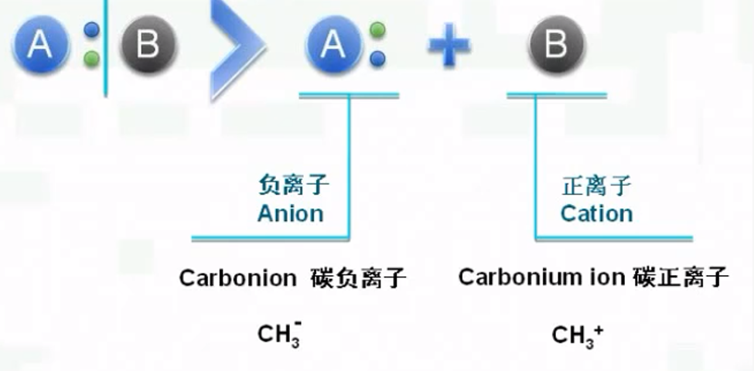
Hetrolytic cleavage(异裂)
Heterolytic cleavage is the breaking of a covalent bond in which the bonding pair of electrons transfers entirely to one of the two bonded atoms, producing a cation and an anion
Notes:
Now let's examine the first 10 straight-chain alkanes in detail — this is Table 24.3 from your textbook, and it's one of the most important reference tables in organic chemistry. Notice the systematic pattern: each successive member adds exactly one CH₂ unit. Watch the boiling points — they increase from methane at −161°C all the way to decane at 174°C. This is a direct consequence of increasing London dispersion forces as the molecular surface area grows. Also note the critical phase transition: alkanes with 1 to 4 carbon atoms are gases at room temperature, those with 5 to 17 carbons are liquids, and those with 18 or more are solids. This gas-to-liquid boundary between butane (−0.5°C) and pentane (36°C) is frequently tested on AP exams.

Slide 13
Electronegativity
C:2.5 H:2.2
So which kind of bond cleavage do we use ? homolytic or heterolytic, ?
Free-Radical Reactions
Notes:
Now let's examine the first 10 straight-chain alkanes in detail — this is Table 24.3 from your textbook, and it's one of the most important reference tables in organic chemistry. Notice the systematic pattern: each successive member adds exactly one CH₂ unit. Watch the boiling points — they increase from methane at −161°C all the way to decane at 174°C. This is a direct consequence of increasing London dispersion forces as the molecular surface area grows. Also note the critical phase transition: alkanes with 1 to 4 carbon atoms are gases at room temperature, those with 5 to 17 carbons are liquids, and those with 18 or more are solids. This gas-to-liquid boundary between butane (−0.5°C) and pentane (36°C) is frequently tested on AP exams.

Slide 14
Free-Radical Reactions
Notes:
Now we enter the heart of organic chemistry — hydrocarbon classification. Hydrocarbons are the simplest organic compounds, containing only carbon and hydrogen, yet they divide into four distinct families based on their carbon-carbon bond types. Mastering these four types is essential for everything that follows.

Slide 15

Free-Radical Reactions P1175-1176
Here, we will begin our study of mechanisms and the three steps to a radical chain reaction:
1. Initiation(引发)
2. Propagation（增长）
3. Termination（终止）
For Example:
Notes:
Now let's examine the first 10 straight-chain alkanes in detail — this is Table 24.3 from your textbook, and it's one of the most important reference tables in organic chemistry. Notice the systematic pattern: each successive member adds exactly one CH₂ unit. Watch the boiling points — they increase from methane at −161°C all the way to decane at 174°C. This is a direct consequence of increasing London dispersion forces as the molecular surface area grows. Also note the critical phase transition: alkanes with 1 to 4 carbon atoms are gases at room temperature, those with 5 to 17 carbons are liquids, and those with 18 or more are solids. This gas-to-liquid boundary between butane (−0.5°C) and pentane (36°C) is frequently tested on AP exams.

Slide 16

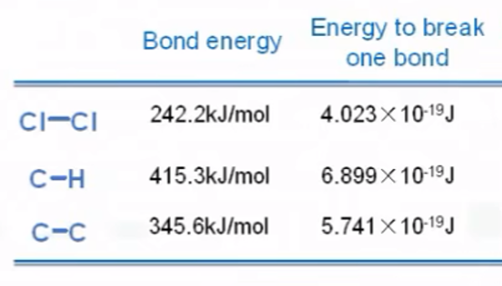
Step 1:Initiation
ΔH=242.7KJ/mol
Notes:
Now let's examine the first 10 straight-chain alkanes in detail — this is Table 24.3 from your textbook, and it's one of the most important reference tables in organic chemistry. Notice the systematic pattern: each successive member adds exactly one CH₂ unit. Watch the boiling points — they increase from methane at −161°C all the way to decane at 174°C. This is a direct consequence of increasing London dispersion forces as the molecular surface area grows. Also note the critical phase transition: alkanes with 1 to 4 carbon atoms are gases at room temperature, those with 5 to 17 carbons are liquids, and those with 18 or more are solids. This gas-to-liquid boundary between butane (−0.5°C) and pentane (36°C) is frequently tested on AP exams.

Slide 17
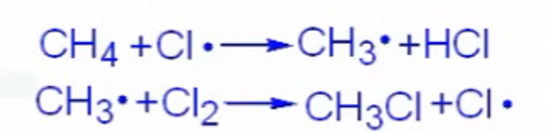
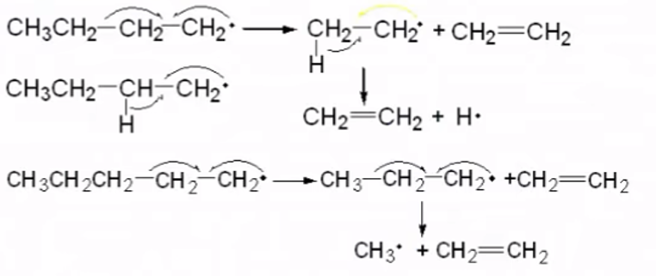

Step 2:Propagation
ΔH=7.5KJ/mol
ΔH=-112.9KJ/mol
Mechanism(机理)
if
ΔH=104KJ/mol
difficult
Notes:
Now let's examine the first 10 straight-chain alkanes in detail — this is Table 24.3 from your textbook, and it's one of the most important reference tables in organic chemistry. Notice the systematic pattern: each successive member adds exactly one CH₂ unit. Watch the boiling points — they increase from methane at −161°C all the way to decane at 174°C. This is a direct consequence of increasing London dispersion forces as the molecular surface area grows. Also note the critical phase transition: alkanes with 1 to 4 carbon atoms are gases at room temperature, those with 5 to 17 carbons are liquids, and those with 18 or more are solids. This gas-to-liquid boundary between butane (−0.5°C) and pentane (36°C) is frequently tested on AP exams.

Slide 18
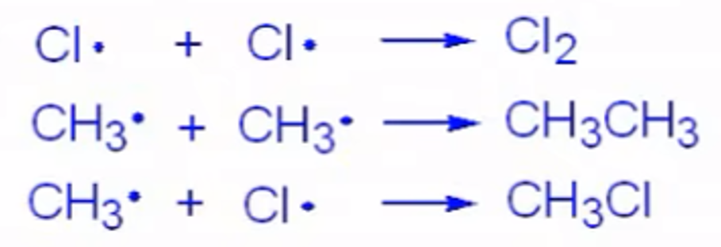

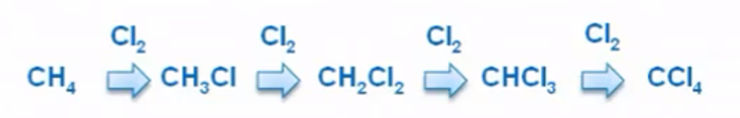
Step 3:Termination
Substitution reaction(取代反应)
Chain reaction(连锁反应)
Notes:
Now let's examine the first 10 straight-chain alkanes in detail — this is Table 24.3 from your textbook, and it's one of the most important reference tables in organic chemistry. Notice the systematic pattern: each successive member adds exactly one CH₂ unit. Watch the boiling points — they increase from methane at −161°C all the way to decane at 174°C. This is a direct consequence of increasing London dispersion forces as the molecular surface area grows. Also note the critical phase transition: alkanes with 1 to 4 carbon atoms are gases at room temperature, those with 5 to 17 carbons are liquids, and those with 18 or more are solids. This gas-to-liquid boundary between butane (−0.5°C) and pentane (36°C) is frequently tested on AP exams.

Slide 19
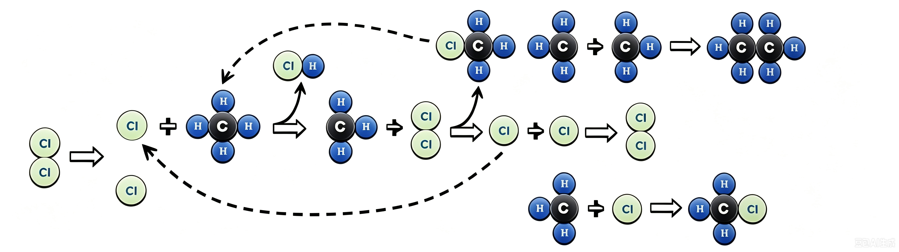
Summary
Step 1:Initiation
Step 2:Propagation
Step 3:Termination
or
Notes:
Now let's examine the first 10 straight-chain alkanes in detail — this is Table 24.3 from your textbook, and it's one of the most important reference tables in organic chemistry. Notice the systematic pattern: each successive member adds exactly one CH₂ unit. Watch the boiling points — they increase from methane at −161°C all the way to decane at 174°C. This is a direct consequence of increasing London dispersion forces as the molecular surface area grows. Also note the critical phase transition: alkanes with 1 to 4 carbon atoms are gases at room temperature, those with 5 to 17 carbons are liquids, and those with 18 or more are solids. This gas-to-liquid boundary between butane (−0.5°C) and pentane (36°C) is frequently tested on AP exams.

Slide 20
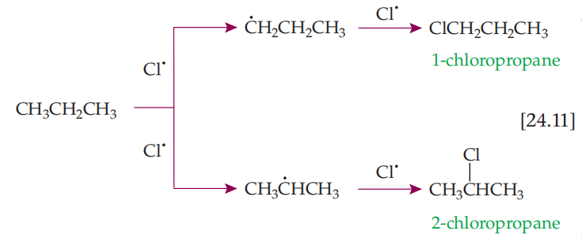
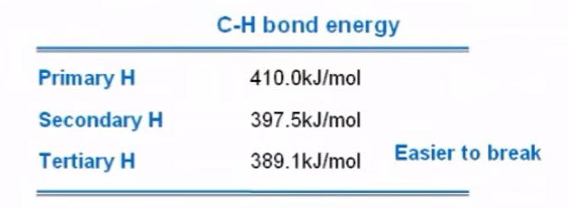
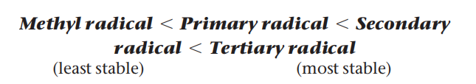
Pay attention
Reason 1:
Reason 2:
Typically, the ratio of selectivity for monochlorination is of the order 1° : 2° : 3° = 1 : 4 : 5
Notes:
Now let's examine the first 10 straight-chain alkanes in detail — this is Table 24.3 from your textbook, and it's one of the most important reference tables in organic chemistry. Notice the systematic pattern: each successive member adds exactly one CH₂ unit. Watch the boiling points — they increase from methane at −161°C all the way to decane at 174°C. This is a direct consequence of increasing London dispersion forces as the molecular surface area grows. Also note the critical phase transition: alkanes with 1 to 4 carbon atoms are gases at room temperature, those with 5 to 17 carbons are liquids, and those with 18 or more are solids. This gas-to-liquid boundary between butane (−0.5°C) and pentane (36°C) is frequently tested on AP exams.

Slide 21
Homework
P1182-1183 24.78、24.80、24.82 周一交
Notes:
Let's cover three interconnected concepts. First, IUPAC nomenclature — the prefix indicates the number of carbon atoms: meth- for 1, eth- for 2, prop- for 3, and so on up to dec- for 10. The suffix '-ane' identifies the compound as an alkane. So 'hexane' tells you immediately: 6 carbons, all single bonds. Second, the homologous series — this is a family of compounds where each successive member differs by exactly one CH₂ unit. Members share the same general formula, similar chemical properties, and show gradual changes in physical properties. This is one of the most powerful predictive frameworks in organic chemistry. Third, real-world applications: methane and butane (C₁–C₄) serve as gaseous fuels — methane for heating, butane for lighters. Longer-chain alkanes from C₂₀ to C₃₀ are used in candles, waxes, and lubricants due to their stability and high viscosity.

